Slide 1
Packet Matching on FPGAs Using HMC Memory :Towards One Million Rules
Authors : Daniel Rozhko,Geoffrey Elliot,Daniel Ly-Ma,Paul Chow,Hans-Arno Jacobsen
University of Toronto,ON,Canada
Presenter : Yi-Fang, Huang
Conference : 25th Proceedings of the 2017 ACM/SIGDA International Symposium on Field-Programmable Gate Arrays
Notes:
1

Slide 2
Outline
Introduction
Implementation
Evaluation
Notes:
2

Slide 3
Introduction
FPGAs – with their reconfigurable nature and high bandwidth interfaces – represent a logical choice for networking infrastructure. However, their limited memory restricts the amount of information that can be stored within the chip, and off-chip memories are typically too slow to meet the demands of high-speed networks.
Hybrid Memory Cube (HMC) based memories present one avenue to alleviate this bottleneck. At a high level, an HMC module consists of stacks of DRAM memory connected vertically by through silicon vias (TSVs) .
Notes:
由於FPGA的可重複改寫的特性和高頻寬介面，使FPGA成為發展網路架構的選擇。
但是，它們的有限內存限制了可以存儲在芯片內部的information，並且off chip memory通常太慢以至於不能滿足高速網絡的需求。

Slide 4
Complete system architecture
Notes:
過濾幾個數據包時，所有通過link的數據包必須檢查filter為 正常運行的

Slide 5
HW and Development Framework
The system was designed to use a Micron AC-510 FPGA accelerator card, which features 4GB of HMC connected over two 8-lane SerDes links to a Xilinx Kintex Ultrascale 060 FPGA
As part of the infrastructure to support the AC-510 and HMC, Micron provides the Pico Framework , a wrapper for the FPGA to include the PCIe and HMC links in hardware designs , as well as software libraries and drivers for the host CPU. These libraries allow for simple software development and a simple protocol for communicating between the host and the FPGA/HMC.

Slide 6
Test Packet Generator
The Micron AC-510 Board was chosen for its HMC memory module, but it lacks the network interface that would allow our system to be tested in a real network deployment.
Instead, our architecture was tested with a spoofed network interface: packets were generated and results verified onchip.
The Test Packet Generator creates and sends a continuous stream of packets at a line rate of up to 10 Gbps. Rather than generate random packets on-chip, this component holds a group of pre-generated packets in on-chip memory and sends them in an infinite loop. The random packets themselves are generated in software and streamed to the test framework at initialization time through the Pico Framework. Note, since the random packets are generated in software, the expected match results can also be computed in software and sent to the system at initialization time
Notes:
Spoofed:模仿
由軟體產生Packet且透過Test Packet Generator 把預先產生的Packet存到on-chip memory(block ram) ，然後用一個無窮迴圈重複送。

Slide 7
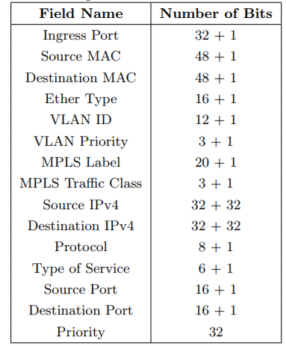
Packet Header Extractor
The Packet Header Extractor parses the Ethernet stream and separates the packet header bits into their corresponding fields , to be processed by the Packet Matching Engine. Note, this component also tags each packet with an ingress timestamp (from a global counter), for the calculation of packet latency.
Openflow1.1.0 match fields
Notes:
Spoofed:模仿
由軟體產生Packet且透過Test Packet Generator 把預先產生的Packet存到on-chip memory(block ram) ，然後用一個無窮迴圈重複送。

Slide 8
Output Result Verifier
Finally, the Output Result Verifier receives the match results from the Matching Engine and verifies that the correct match was made. These correct matches are computed in software and streamed to the component at initialization time to be stored in on-chip memory.
The verifier streams the number of errors and some statistics back to the host on a packet-batch basis (i.e. one iteration of the packet infinite loop).
The statistics include the average packet latency for the batch (calculated using the global counter and packet timestamp), the total counter cycles taken for the batch (to calculate throughput), and the total number of rule fetch cycles taken for the batch (to calculate memory bandwidth).
Notes:
Spoofed:模仿

Slide 9
Outline
Introduction
Implementation
Evaluation
Notes:
9

Slide 10
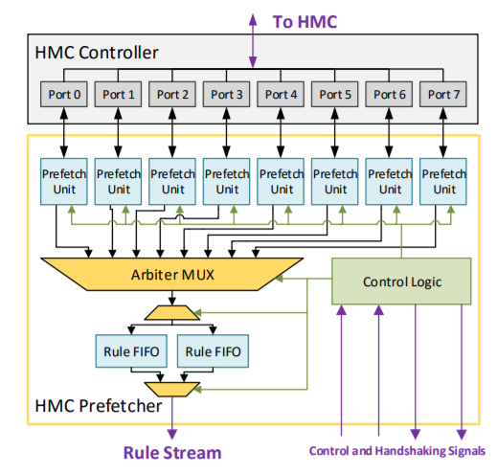
HMC Memory Prefetcher
the FPGA fabric has ten ports with which to access the HMC. The vendor-provided framework reserves one port for host access, leaving nine ports for use by the prefetcher. To simplify the request logic, the prefetcher distributes requests over eight of the nine ports.
each of the eight HMC ports is connected to an individual prefetching unit. Each unit issues 128-byte (2-rule) requests from the HMC in a sequential order to minimize the response time.
Note: (Bus width = 8(HMC ports number
)*128byte=1KB)
Notes:
過濾幾個數據包時，所有通過link的數據包必須檢查filter為 正常運行的

Slide 11
HMC Memory Prefetcher
Each response is returned in eight 16-byte segments, which are collected and split into the two rules. Each unit feeds these rules into an arbiter multiplexer, which coalesces the eight streams into one. Once all the rules have been retrieved (based on the value of the global RuleCount register at the start of a cycle), the prefetcher then issues requests for up to 1/4 of the rules prior to the start of another match cycle.
This minimizes the downtime of the HMC link, but does limit alterations to the ruleset – namely, that the ruleset cannot shrink by more than 75% on a given matching cycle.
Notes:
過濾幾個數據包時，所有通過link的數據包必須檢查filter為 正常運行的
再所有Rules都到達Prefetcher時，prefetcher會在下一個matching cycle開始前，發出最多1/4的rule request ，
這樣可以漸少HMC link沒有在傳輸rule的時間，然而最多也就只能把ruleset 縮到75%的Rules。

Slide 12
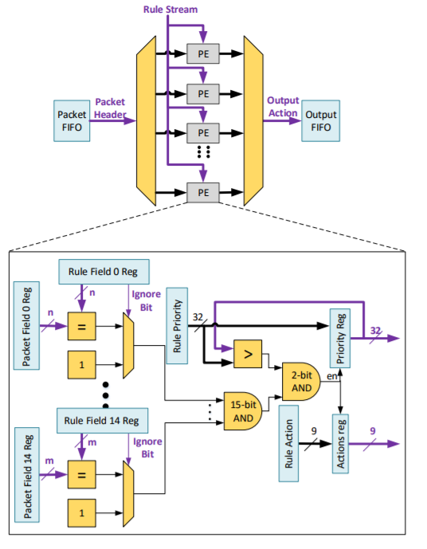
Packet Matching Engine
The packet matching engine compares the headers of incoming packets against a ruleset and outputs the action of the highest priority matching rule.
Rules and packet headers are streamed in from two FIFOs that are populated by the Packet Header Extractor and Memory Prefetcher circuits respectively.
The processing engine (PE) compares all the fields in the packet with the fields of each rule. The outputs of these comparisons are logically ANDed together to check if all fields of a particular rule have been matched. Exact match fields will output true(1) if the mask bit is low(0).
Internal registers keep track of the highest priority rule and its corresponding action. Each new matching rule’s priority is compared against the current highest priority and if the priority of the new rule is higher, these registers will take on the values of the new rule.
Notes:
過濾幾個數據包時，所有通過link的數據包必須檢查filter為 正常運行的

Slide 13
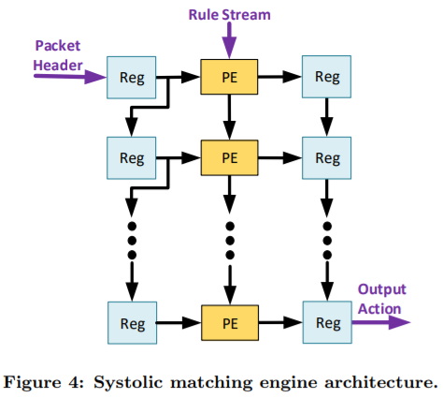
Systolic matching engine Architecture
Since rules are read in sequentially, having more PEs will allow for more packets to be processed in parallel, thus increasing the throughput. However, we discovered that this architecture did not scale well with the number of PEs as it was difficult to meet timing for more than 100 PEs. This was due to the increasingly large fanout of the Rule Stream data signal and the deepening of the LUT levels required for the multiplexer and demultiplexer logic as the number of PEs increased.
Our second architecture, tries to overcome these shortcomings.
First, the PEs are placed in a systolic array architecture to reduce the fanout of the Rule Stream data signal and remove the need for the large multiplexer and demultiplexer. Packet headers in the FIFO are sequentially shifted through the array until either the FIFO is empty or the array is full.
Notes:
Since rules are read in sequentially, having more PEs will allow for more packets to be processed in parallel, thus increasing the throughput. Our first architecture, shown in Figure 3, was designed using Vivado HLS and uses a demultiplexer to load packets into an array of PEs and uses a multiplexer to sequentially send the outputs to the output FIFO. This architecture’s simplicity makes it good for prototyping a proof of concept. However, we discovered that this architecture did not scale well with the number of PEs as it was difficult to meet timing for more than 100 PEs. This was due to the increasingly large fanout of the Rule Stream data signal and the deepening of the LUT levels required for the multiplexer and demultiplexer logic as the number of PEs increased.

Slide 14
Systolic matching engine Architecture
The PEs load the header into their internal registers and rules are then sequentially shifted through the array for each PE to compare against its header.
Once all the rules have been shifted through, the output of the PEs are loaded into a parallel shift register and then shifted into the output FIFO.
These optimizations allowed us to pack 60% more PEs (160 in total) into the matching engine.
Notes:
Since rules are read in sequentially, having more PEs will allow for more packets to be processed in parallel, thus increasing the throughput. Our first architecture, shown in Figure 3, was designed using Vivado HLS and uses a demultiplexer to load packets into an array of PEs and uses a multiplexer to sequentially send the outputs to the output FIFO. This architecture’s simplicity makes it good for prototyping a proof of concept. However, we discovered that this architecture did not scale well with the number of PEs as it was difficult to meet timing for more than 100 PEs. This was due to the increasingly large fanout of the Rule Stream data signal and the deepening of the LUT levels required for the multiplexer and demultiplexer logic as the number of PEs increased.

Slide 15
Outline
Introduction
Implementation
Evaluation
Notes:
15

Slide 16
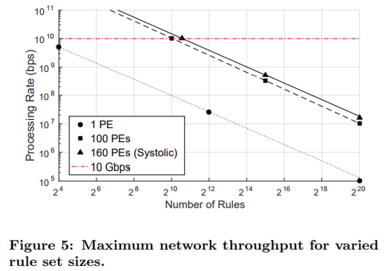
Packet Throughput & Processing Latency
Two entries in the table correspond to our work: the system tested with 1504 rules (max rule count at 10 Gbps) and 2^20= 1048576 rules, as the first and second entries respectively. We note that previous systems outperform our implementation at lower rule counts; this is expected, since these systems utilize only on-chip memory. Our off-chip memory solution is the only hardware system (to the best of our knowledge) that can support much larger rule counts, achieving a processing rate of 16.4 Mbps at 1M rules.
Notes:
Table 2 presents the packet throughput of our best system, 160 systolic PEs, along with other state-of-the-art hardware implementations of packet matching systems. Two entries in the table correspond to our work: the system tested with 1504 rules (max rule count at 10 Gbps) and 220 = 1048576 rules, as the first and second entries respectively. We note that previous systems outperform our implementation at lower rule counts; this is expected, since these systems utilize only on-chip memory. Our off-chip memory solution is the only hardware system (to the best of our knowledge) that can support much larger rule counts, achieving a processing rate of 16.4 Mbps at 1M rules.

Slide 17
Resource Utilization
Notes:
如果user指定了某個pad(Pcap中某個Packet段)，則它將包含在模塊頭中

